Slide 1
Event Management System
Submitted By:
Shubham Nandedkar

Slide 2
Agenda
➢Brief overview
➢Statement of the problem
➢Proposed system
➢Overview
➢Tools & Technology
➢Expected Outcome

Slide 3
Overview
With the advancement in the technology, in the world people are trying to get things on the desk without wasting anytime as nowadays time is the most important thing in the world. Because of technology people are trying to get knowledge of their jobs as well. Organizations also have to advertise about the jobs in newspapers and television which is time consuming .

Slide 4
Problem Statement
The problem arose when one wanted to organize an event. The amount of time that was wasted in finding all services required robbed the customer of enjoying the joys of an occasion. Since, there was a non-availability of a user-friendly platform that not only housed a variety of services but also at the most competitive rates.

Slide 5
Introduction
Event management is the process by which an event is planned, prepared, and produced. As with any other form of management, it encompasses the assessment, definition, acquisition, allocation, direction, control, and analysis of time, finances, people, products, services, and other resources to achieve objectives. An event manager's job is to oversee and arrange every aspect of an event, including researching, planning, organizing, implementing, controlling, and evaluating

Slide 6
Purpose
The purpose of designing the event Management System is to give the platform for the users to book their events online by giving details of their events and information. So that they will directly contact the admin for the events.

Slide 7
Scope
Event Management courses are the talk of the town nowadays because of the element of glitz, glamour, flamboyance and style associated with important social and corporate events like marriages, birthday parties, company conferences, seminars, workshops, product launches and a host of other activities.
With the fashion and film industry evolving, engulfing and dominating our lifestyle like never before, there is a surge of fashion & celebrity shows, film awards, celebrity promotions, road shows and more.

Slide 8
Main Module
Customers
Admin of site

Slide 9
Tools & Technology
➢Php
➢My Sql
➢HTML
➢CSS
➢Java script
➢Notepad++
➢XAMPP server
➢Bootstrap

Slide 10
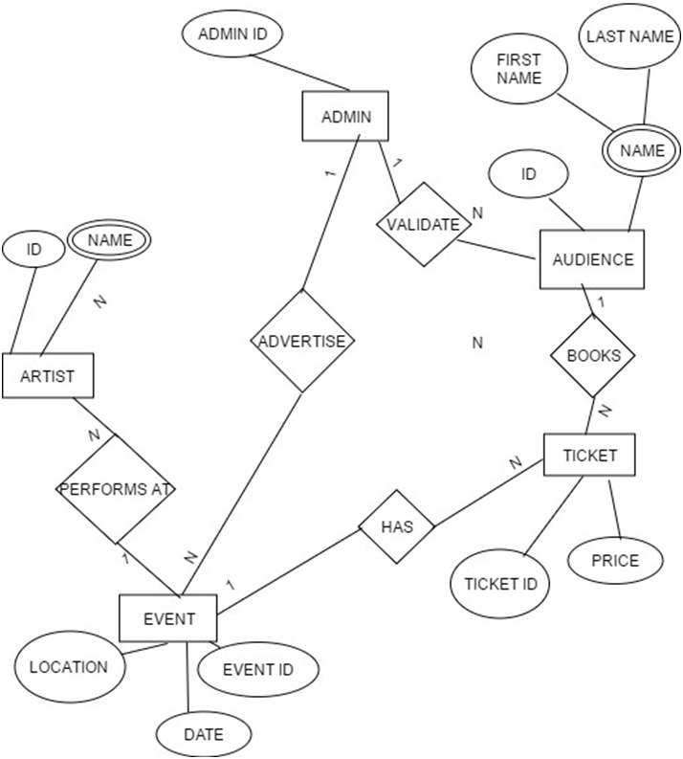
ER-Diagram

Slide 11
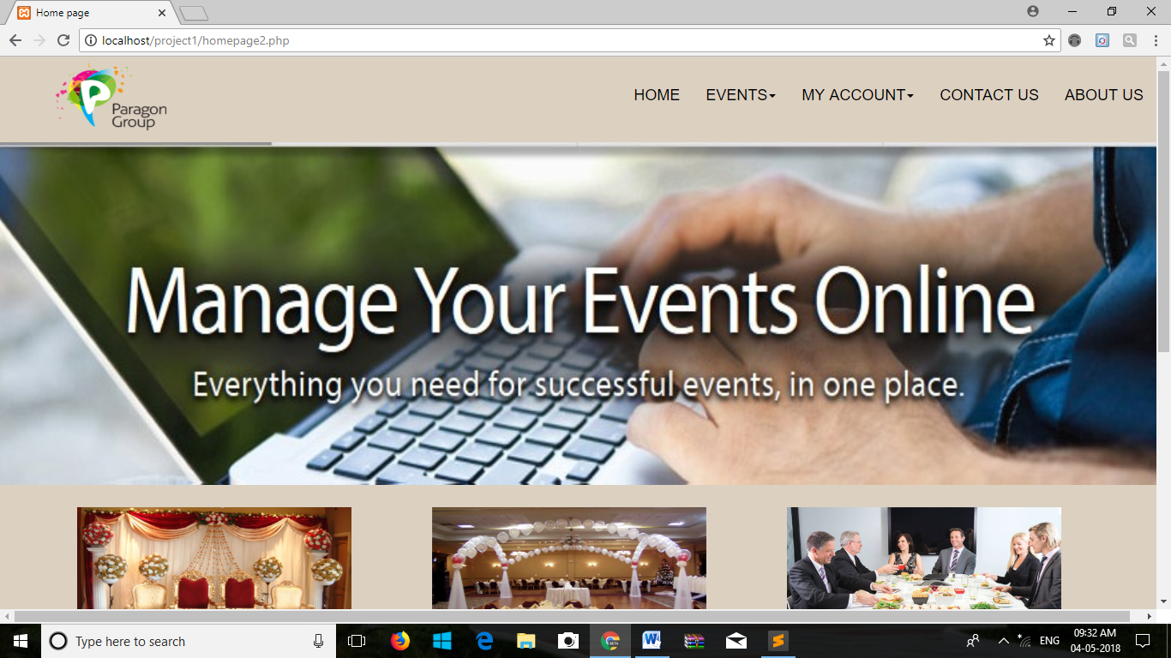
Homepage of my website

Slide 12
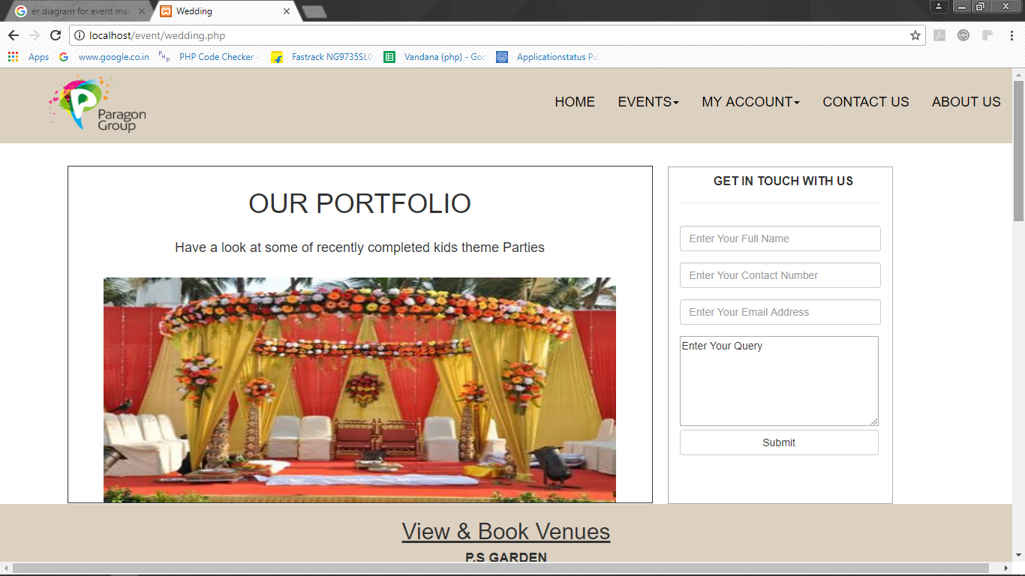
Portfolio:

Slide 13
Thank You

